Slide 1
Immunity & Vaccines
Chapter 11 – Part 2

Slide 2
Passive and Active Immunity
Passive
the short-term immunity which results from the introduction of antibodies from another person or animal
The individual’s body plays no part in the production of antibodies
Lasts until antibodies are broken down
Active
the immunity which results from the production of antibodies by the immune system in response to the presence of an antigen
Long term immunity - results in memory of antigen

Slide 3
Natural immunity
Resistance to infection by a pathogen that occurs without any outside human intervention
Passive – mother’s antibodies enter from the placenta or through breast milk
Active – antibodies and memory cells manufactured in response to natural exposure to an antigen

Slide 4
Artificial immunity
Resistance to infection by a pathogen that occurs when a person is injected with an antibody or an antigen
Passive – antibodies are injected into the bloodstream.
Active – an antigen is injected and the body responds to the antigen creating antibodies and memory cells.

Slide 6
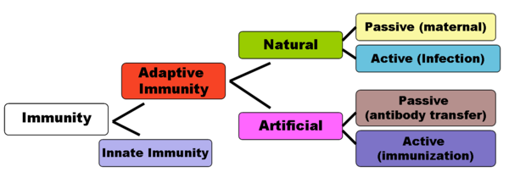

Slide 7
Vaccines produce immunity
Immunisation – programming the immune system so that the body can respond rapidly to infecting micro-organisms
Vaccination – artificial introduction of antigens (from a pathogen) so that the person can produce the appropriate antibodies without having to suffer the disease
Vaccine – is the antigen mixture that is given to the person

Slide 8
Four (4) types of vaccines
Attenuated pathogens
Reduced virulence
Bacteria may be kept at high temperatures for a period of time and then given as a vaccine to people
E.g. polio, tuberculosis, measles
Dead micro-organisms
the immunity is shorter lived
E.g. cholera, typhoid, whooping cough

Slide 9
Four (4) types of vaccines
Toxoids
filtrates of bacterial cultures
The toxins are separated and inactivated before being injected into the person.
Useful for bacteria which produce toxins
E.g. diphtheria and tetanus
Sub-unit
a fragment of the micro-organism is sufficient to provoke the immune response
E.g. HPV (Gardasil) and Hepatitis B

Slide 10
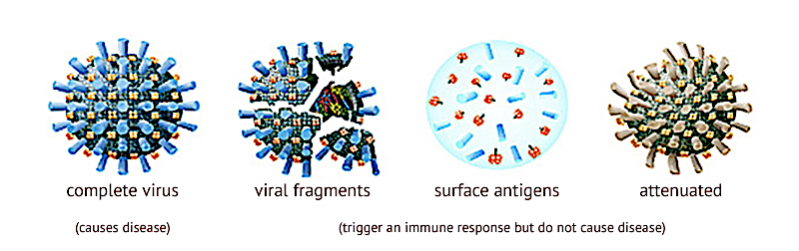

Slide 11
Side effects
Very effective, usually harmless
a small number of people suffer severe side effects
Severe allergic reactions can occur
1/million children given the whooping cough vaccine die from severe damage to the nervous system
There is ethical debate that surrounds the vaccination of children

Slide 12
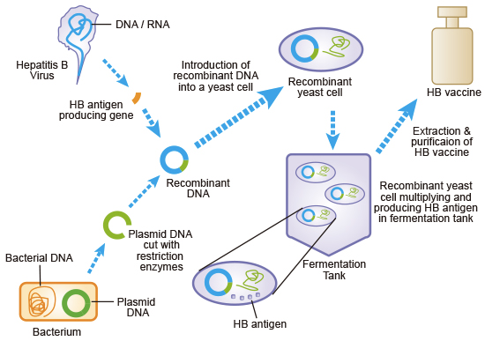
Recombinant DNA

Slide 13
Delivery of vaccines
Injection from a syringe
Oral via a syrup
Sugar cubes/lumps
The use of other administrations are being investigated. These include:
Nasal spray
Skin patches

Slide 14
Vaccinations and booster shots
First dose of vaccine does not enable enough B cells to become activated (more activated B cells, more antibodies made)
Booster shots are therefore needed
Timing is essential

Slide 15
Public health considerations
The World Health Organisation (WHO) push vaccination because of the significant effect it has on preventing suffering from disease overall.
Vaccination has lead to the elimination of small pox.
Herd immunity
Gained when a large proportion of a population have immunity from a pathogen. The pathogen is less likely to be transmitted between people.

Slide 16
Herd immunity

Slide 17
Why object to vaccinations
Possible adverse reactions
Allergic reaction
Medium in which the vaccine was cultured
e.g. flu vaccines are generally manufactured in fertilised eggs
Dangerous preservatives
Formaldehyde and acetone used to manufacture vaccines – can effect the nervous system
Cross-contamination
Between species (pass on cross-species diseases) as a result of preparation conditions
Some people believe HIV was transmitted from apes to humans via a faulty polio virus given in Africa

Slide 18
Why object to vaccinations
Ethical Concerns
Animal welfare – many vaccines are first tested on animals or require animals in the manufacture of the vaccine
E.g. rubella vaccine is manufactured using the cells from an aborted human foetus
Other reasons not to vaccinate
Religious reasons
Political – objections to government level of control
Complacency – the chances of contracting the disease are less than the chances of suffering side effects

Slide 19
Antibiotics
Drugs used to fight infections, particularly for bacteria
broad spectrum (target wide range of bacteria)
narrow spectrum (targets specific bacteria)
Two types
Bactericidal antibiotics – kill bacteria by changing structure of cell wall/membrane
Bacteriostatic antibiotics – stop bacteria reproducing, usually by disrupting protein synthesis
Overuse of antibiotics leads to multiple drug resistance or total drug resistance

Slide 20
Antivirals
Specifically treat viral infections by inhibiting the development of the virus
Antivirals are required as antibiotics are ineffective against viruses

